Slide 1

SQL (Scratch to Advance)

Slide 2
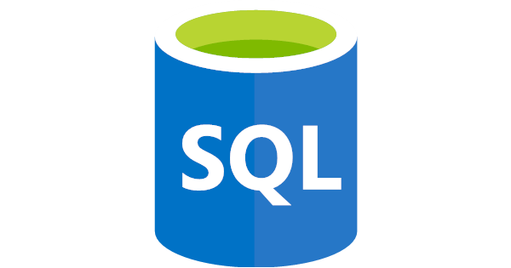
What is SQL?
SQL stands for Structured Query Language
SQL lets you access and manipulate databases
SQL became a standard of the American National Standards Institute (ANSI) in 1986, and of the International Organization for Standardization (ISO) in 1987

Slide 3
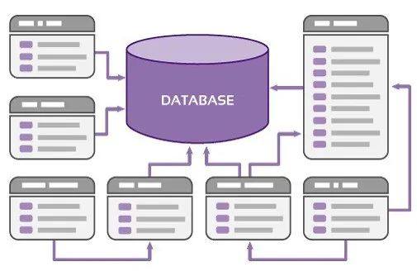
What is Database?
A database is a systematic collection of data. They support electronic storage and manipulation of data. Databases make data management easy.
Types of Databases
Here are some popular types of databases.
Distributed databases:
A distributed database is a type of database that has contributions from the common database and information captured by local computers. In this type of database system, the data is not in one place and is distributed at various organizations.

Slide 4
Types of Databases:--
Relational databases:
This type of database defines database relationships in the form of tables. It is also called Relational DBMS, which is the most popular DBMS type in the market. Database example of the RDBMS system include MySQL, Oracle, and Microsoft SQL Server database.
Object-oriented databases:
This type of computers database supports the storage of all data types. The data is stored in the form of objects. The objects to be held in the database have attributes and methods that define what to do with the data. PostgreSQL is an example of an object-oriented relational DBMS.

Slide 5
Types
Centralized database:
It is a centralized location, and users from different backgrounds can access this data. This type of computers databases store application procedures that help users access the data even from a remote location.
Open-source databases:
This kind of database stored information related to operations. It is mainly used in the field of marketing, employee relations, customer service, of databases.

Slide 6
Types
Cloud databases:
A cloud database is a database which is optimized or built for such a virtualized environment.
NoSQL databases:
NoSQL database is used for large sets of distributed data.
Graph databases:
A graph-oriented database uses graph theory to store, map, and query relationships

Slide 7
Types
OLTP databases:
OLTP another database type which able to perform fast query processing and maintaining data integrity in multi-access environments.
Personal database:
A personal database is used to store data stored on personal computers that are smaller and easily manageable. The data is mostly used by the same department of the company and is accessed by a small group of people.
Multimodal database:
The multimodal database is a type of data processing platform that supports multiple data models that define how the certain knowledge and information in a database should be organized and arranged.

Slide 8
Types
Document/JSON database:
In a document-oriented database, the data is kept in document collections, usually using the XML, JSON, BSON formats. One record can store as much data as you want, in any data type (or types) you prefer.
Hierarchical:
This type of DBMS employs the “parent-child” relationship of storing data. Its structure is like a tree with nodes representing records and branches representing fields. The windows registry used in Windows XP is a hierarchical database example.
Network DBMS:
This type of DBMS supports many-to-many relations. It usually results in complex database structures. RDM Server is an example of database management system that implements the network model.

Slide 9
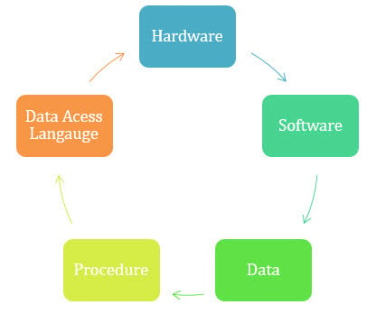
Databases Components

Slide 10
DBMS
Database Management System (DBMS) is a collection of programs that enable its users to access databases, manipulate data, report, and represent data. It also helps to control access to the database.
Advantages of DBMS
DBMS offers a variety of techniques to store & retrieve data.
DBMS serves as an efficient handler to balance the needs of multiple applications using the same data.
Uniform administration procedures for data.

Slide 11
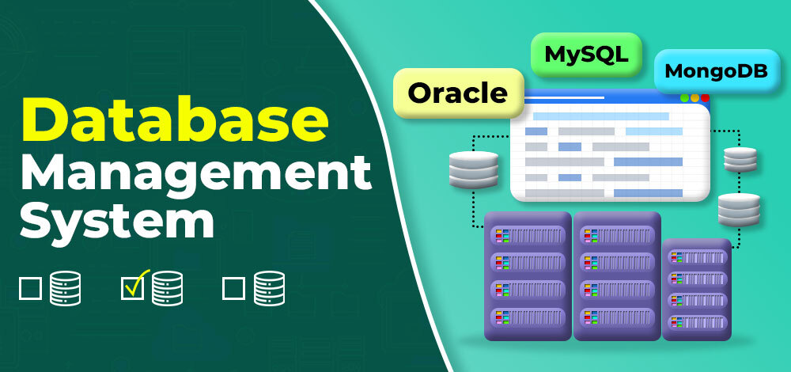
DBMS

Slide 12
Disadvantage
Disadvantage of DBMS
DBMS may offer plenty of advantages but, it has certain flaws-
Cost of Hardware and Software of a DBMS is quite high which increases the budget of your organization.
Most database management systems are often complex systems, so the training for users to use the DBMS is required.

Slide 13
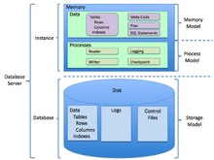
RDBMS
RDBMS stands for Relational Database Management System.
RDBMS is a program used to maintain a relational database.
RDBMS is the basis for all modern database systems such as MySQL, Microsoft SQL Server, Oracle, and Microsoft Access.
RDBMS uses SQL queries to access the data in the database.

Slide 14
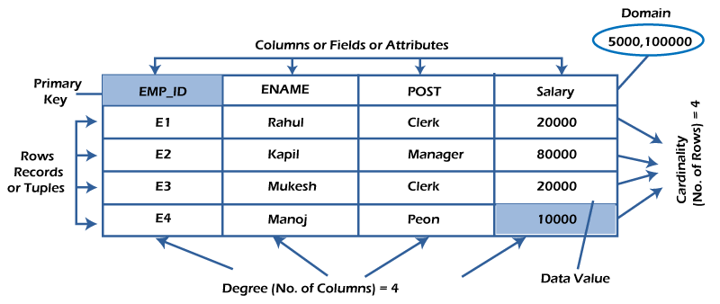
E.g of RDBMS

Slide 15
Table/Row
What is table/Relation?
Everything in a relational database is stored in the form of relations
Properties of a Relation:
Each relation has a unique name by which it is identified in the database.
Relation does not contain duplicate tuples.
What is a row or record?
A row of a table is also called a record or tuple

Slide 16
What is a column/attribute?
A column is a vertical entity in the table which contains all information associated with a specific field in a table.
Properties of an Attribute:
Every attribute of a relation must have a name.
Null values are permitted for the attributes.
What is data item/Cells?
The smallest unit of data in the table is the individual data item. It is stored at the intersection of tuples and attributes.

Slide 17
Domain:
The domain refers to the possible values each attribute can contain
NULL Values
The NULL value of the table specifies that the field has been left blank during record creation. It is different from the value filled with zero or a field that contains space.
Data Integrity
There are the following categories of data integrity exist with each RDBMS:
Entity integrity: It specifies that there should be no duplicate rows in a table.
Domain integrity: It enforces valid entries for a given column by restricting the type, the format, or the range of values.
Referential integrity specifies that rows cannot be deleted, which are used by other records.
User-defined integrity: It enforces some specific business rules defined by users.

Slide 18
Database Schema
A database schema defines how data is organized within a relational database; this is inclusive of logical constraints such as, table names, fields, data types, and the relationships between these entities.
Database schema vs. database instance
A database schema is considered the “blueprint” of a database which describes how the data may relate to other tables or other data models. However, the schema does not actually contain data.

Slide 19
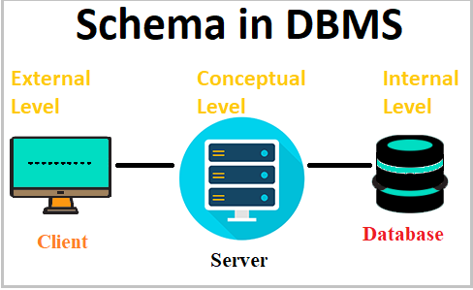
Schema Types:-

Slide 20
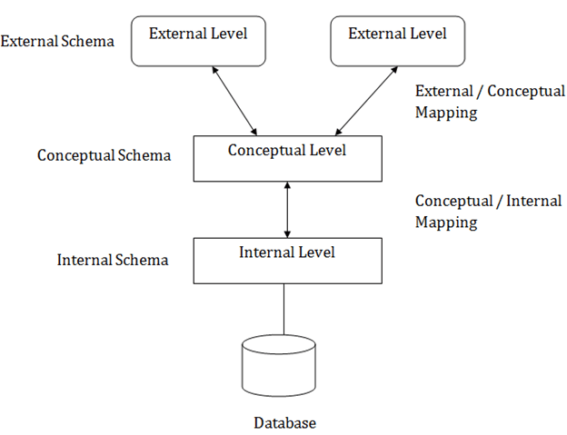
Types of database schemas

Slide 21
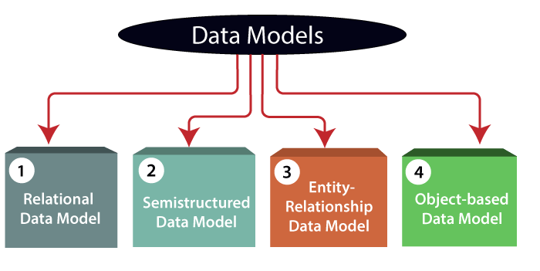
Data Models

Slide 22
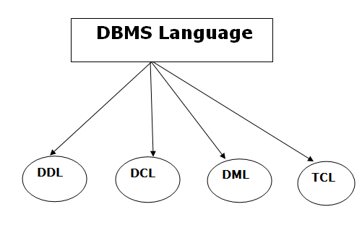
Database Languages

Slide 23
Data Definition Language
DDL stands for Data Definition Language. It is used to define database structure or pattern.
Data definition language is used to store the information of metadata like the number of tables and schemas, their names, indexes, columns in each table, constraints, etc.
Create: It is used to create objects in the database.
Alter: It is used to alter the structure of the database.
Drop: It is used to delete objects from the database.
Truncate: It is used to remove all records from a table.
Rename: It is used to rename an object.
Comment: It is used to comment on the data dictionary

Slide 24
Data Manipulation Langauge
DML stands for Data Manipulation Language. It is used for accessing and manipulating data in a database. It handles user requests.
Select: It is used to retrieve data from a database.
Insert: It is used to insert data into a table.
Update: It is used to update existing data within a table.
Delete: It is used to delete all records from a table.
Merge: It performs UPSERT operation, i.e., insert or update operations.
Call: It is used to call a structured query language or a Java subprogram.
Explain Plan: It has the parameter of explaining data.
Lock Table: It controls concurrency.

Slide 25
Data Control Language
DCL stands for Data Control Language. It is used to retrieve the stored or saved data.
Grant: It is used to give user access privileges to a database.
Revoke: It is used to take back permissions from the user.
There are the following operations which have the authorization of Revoke:
CONNECT, INSERT, USAGE, EXECUTE, DELETE, UPDATE and SELECT.

Slide 26
Transaction Control Langauges
TCL is used to run the changes made by the DML statement. TCL can be grouped into a logical transaction.
Commit: It is used to save the transaction on the database.
Rollback: It is used to restore the database to original since the last Commit.

Slide 27
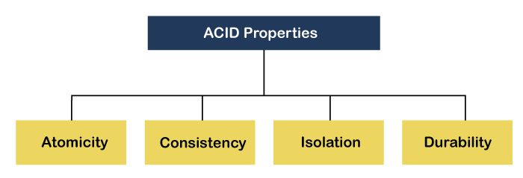
Acid Properties in DBMS

Slide 28
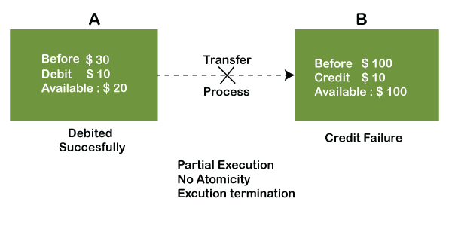
Atomicity

Slide 29
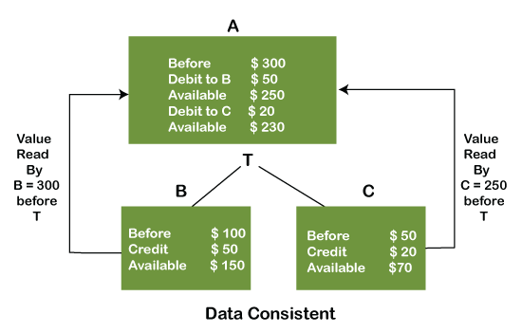
Consistency

Slide 30
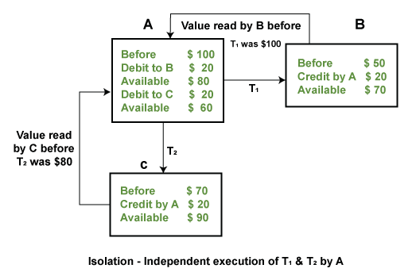
Isolation

Slide 31
Durability
Durability ensures the permanency of something.
In DBMS, the term durability ensures that the data after the successful execution of the operation becomes permanent in the database.
The durability of the data should be so perfect that even if the system fails or leads to a crash, the database still survives.

Slide 32
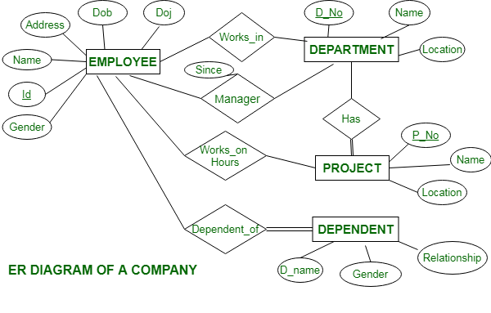
E-R Model

